Slide 1
React Native Style and Layout
Group Member:
1. Pothea Chorn
2. Sereyratha Chann
3. Sokny Norn
4. Sreynieth Leourn
5. Da Doun
Group 5, 11-08-2022

Slide 2
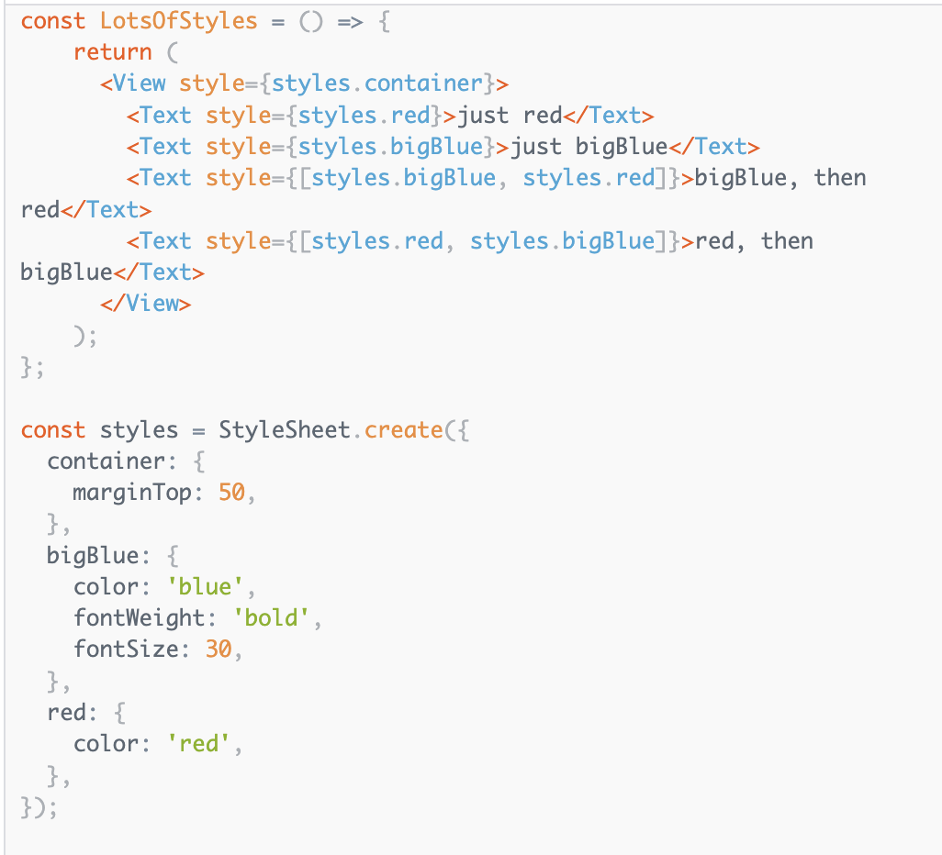
React Native Style
— All of the core components accept a prop named style.
— The style names and values are usually match how css works on web.
— Names are written using camel casing, e.g. backgroundColor
— Can define several styles in one place by using StyleSheet.create, so you can use it to inherit styles.

Slide 3
React Native Layout
—Layout : is the way which design or arrangement of something laid out.
—You will normally use a combination of flexDirection, alignItems, and justifyContent to achieve the right layout.

Slide 4
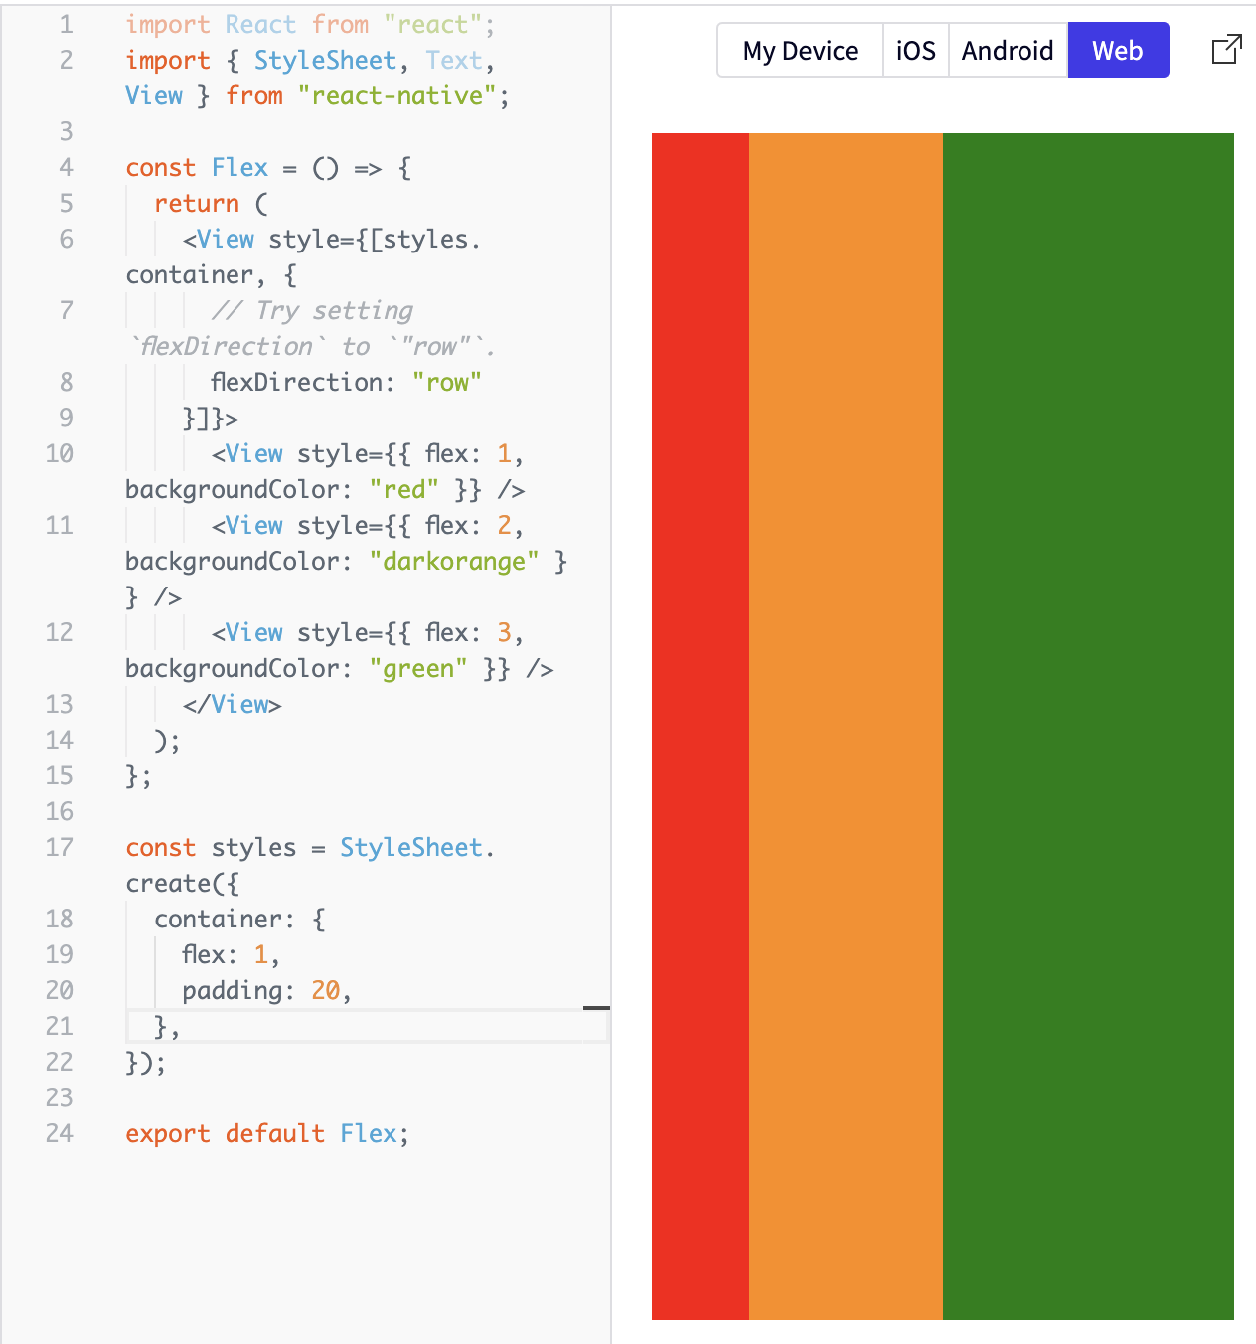
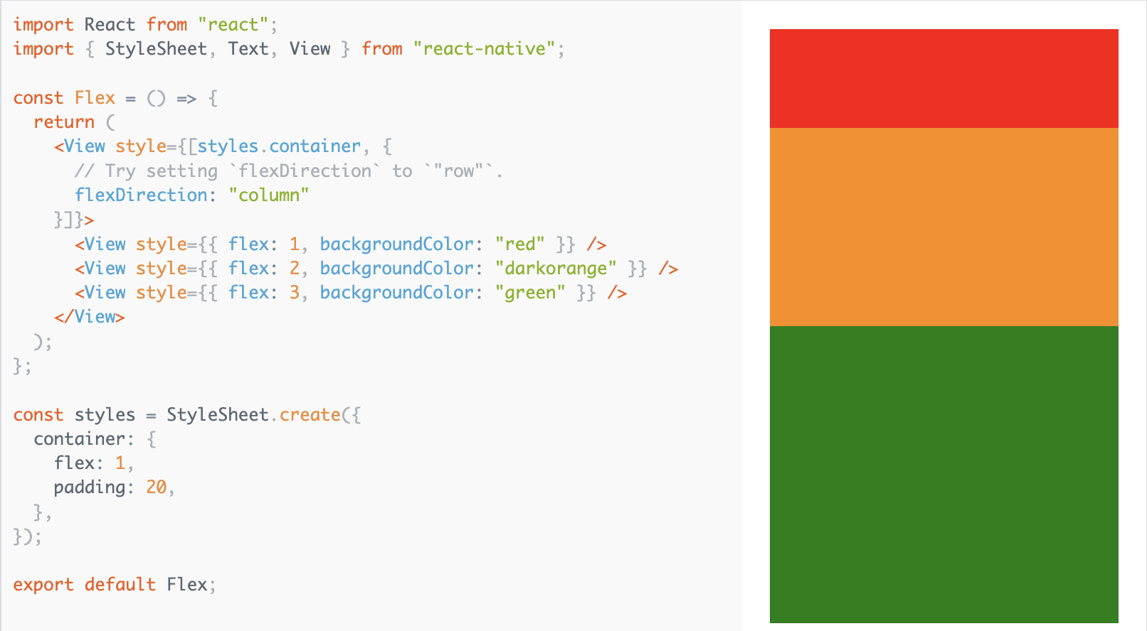
React Native Style
— Flex : will define how your items are going to “fill” over the available space along your main axis.

Slide 5
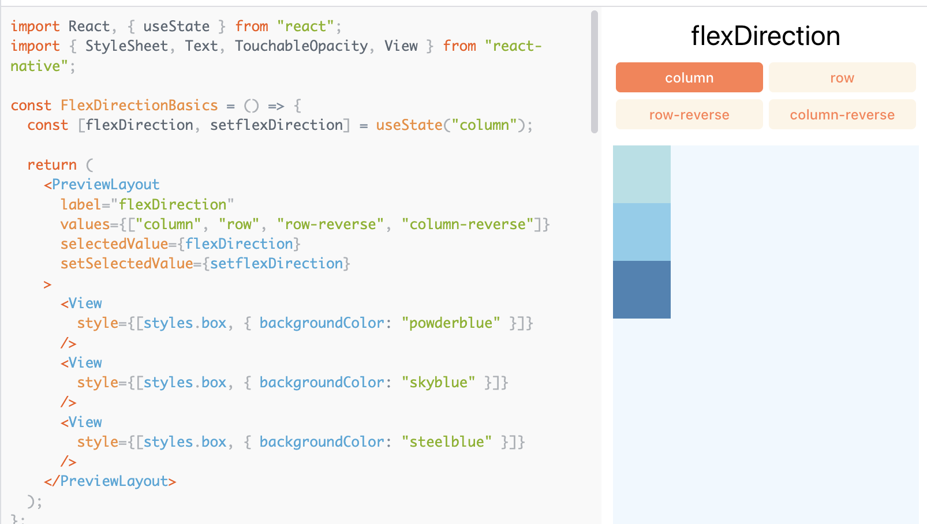
React Native Style
— Flex Direction: controls the direction in which the children of a node are laid out.
— flextDirection values are column, row, row-reverse, column-reverse

Slide 6
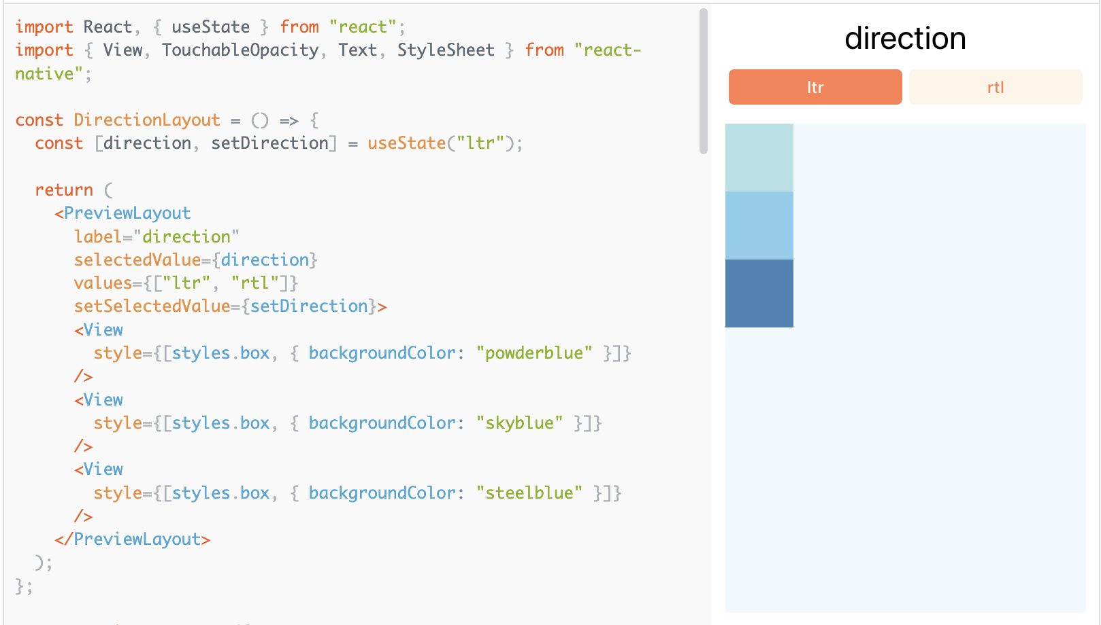
React Native Style
— Layout Direction: specifies the direction in which children and text in a hierarchy should be laid out.
The layout direction affect from start to end or LTR.
— There are two values of direction: LTR, RTL

Slide 7
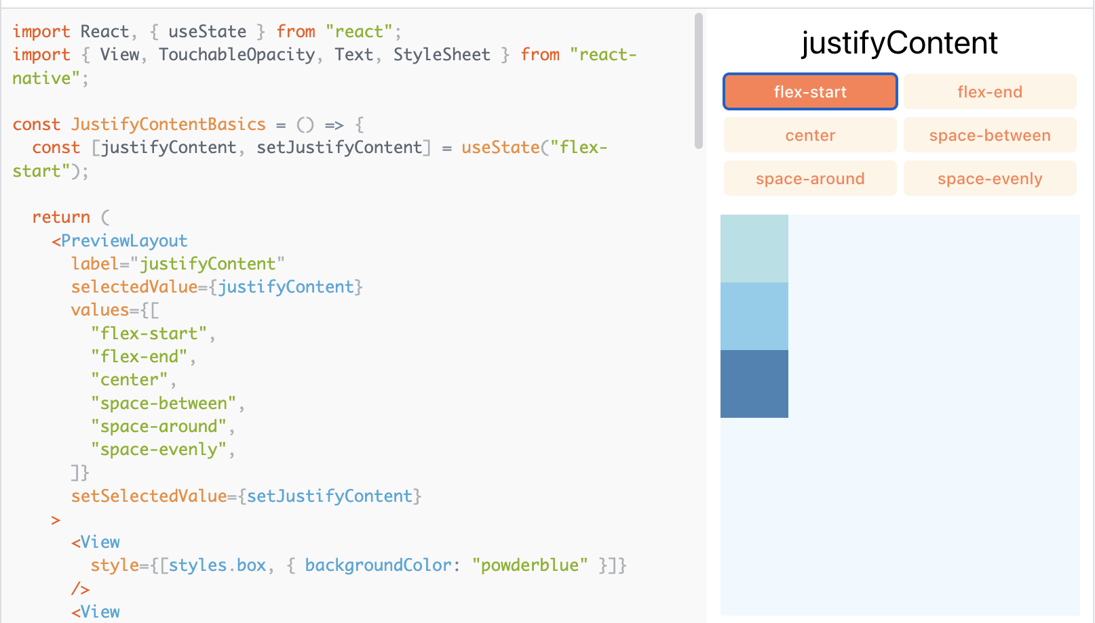
React Native Style
— Justify Content : describes how to align children within the main axis of their container.

Slide 8
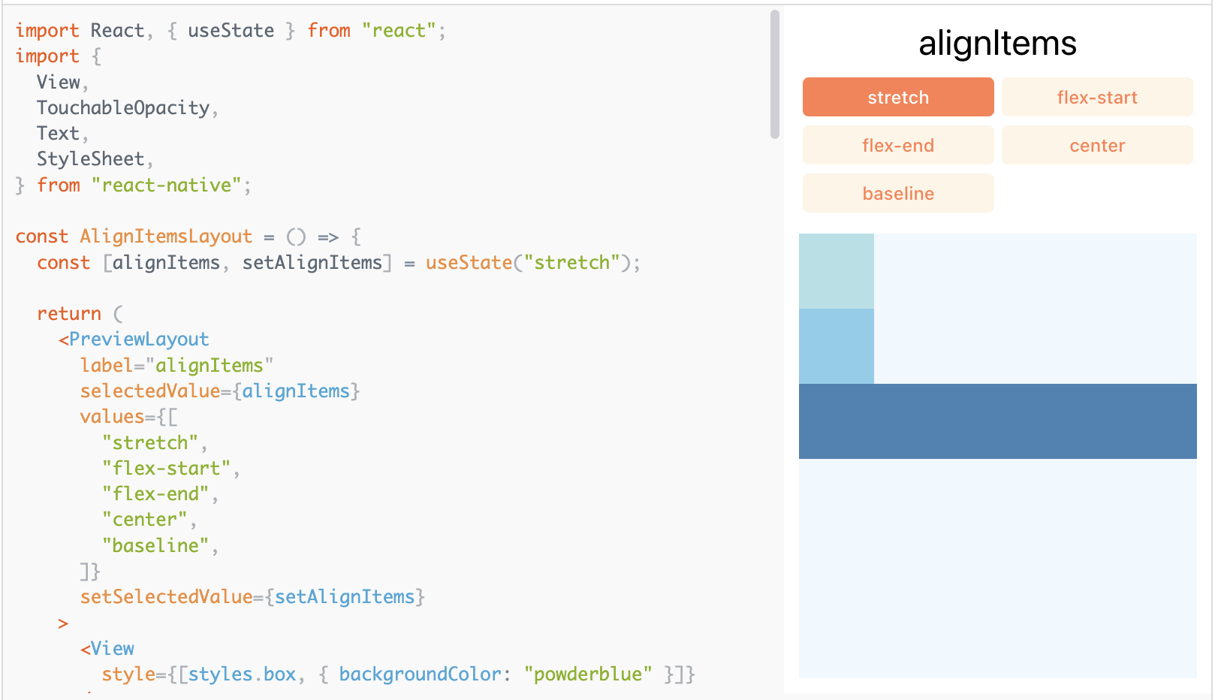
React Native Style
— Align Items : describes how to align children along the cross axis of their container

Slide 9
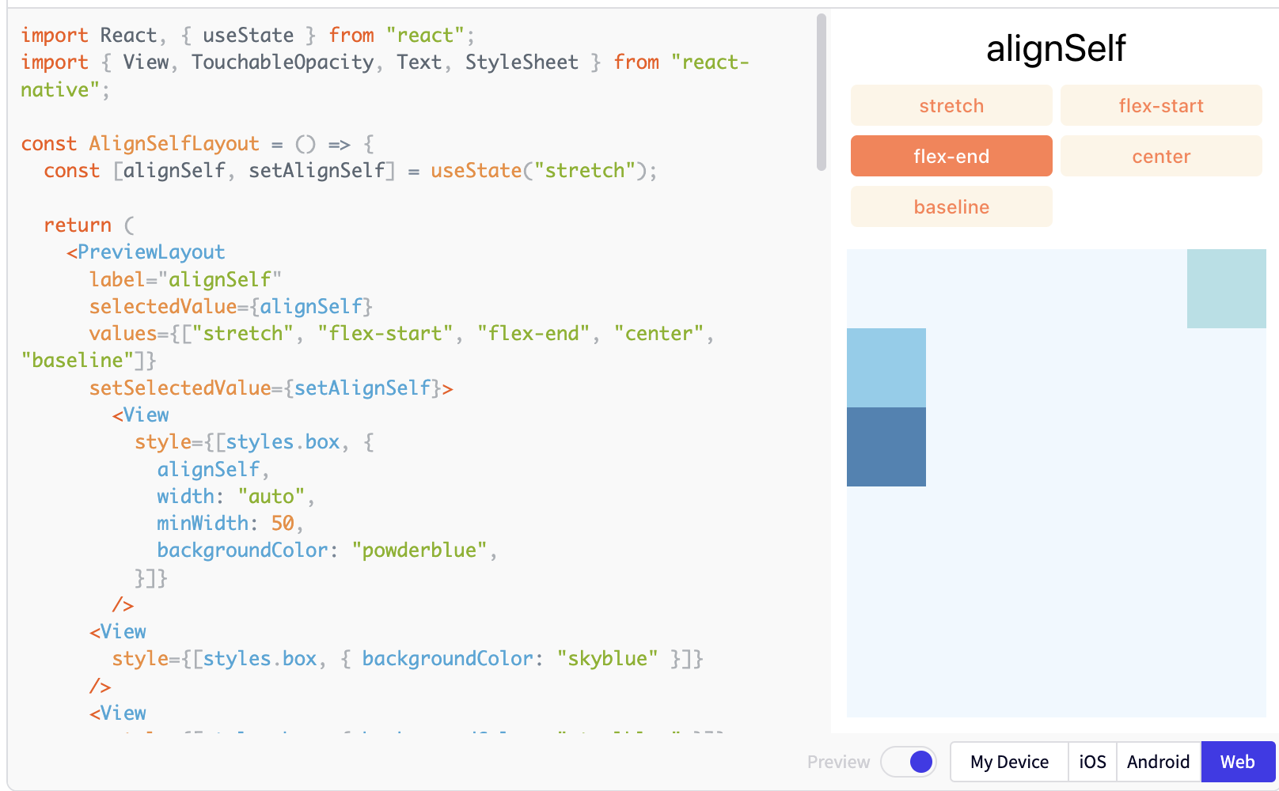
React Native Style
— Align Self :has the same options and effect as alignItems but instead of affecting the children within a container, you can apply this property to a single child to change its alignment within its parent. alignSelf overrides any option set by the parent with alignItems.

Slide 10
References
https://reactnative.dev/docs/flexbox
https://reactnative.dev/docs/style

Slide 11
Thank you

